Slide 1
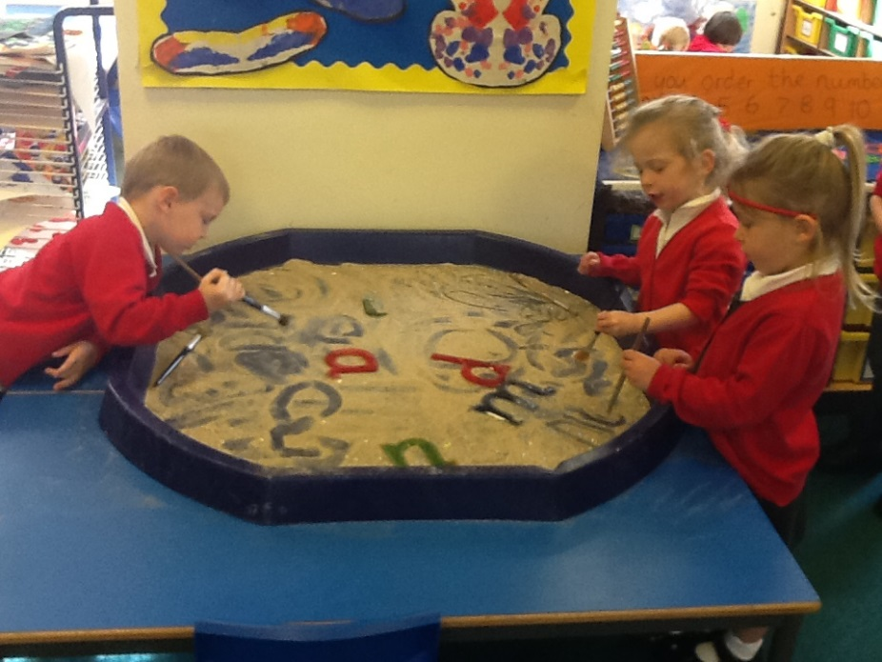
Phonics and Literacy in the Early Years
September 2020
Miss Calboutin, Mrs Hastie and Mrs March

Slide 2
The Early Years Curriculum
40- 60 months, Communication and Language
•Maintains attention, concentrates and sits quietly during appropriate activity.
•Two-channelled attention – can listen and do for short span.
•Responds to instructions involving a two-part sequence.
•Understands humour, e.g. nonsense rhymes, jokes.
•Able to follow a story without pictures or props.
•Listens and responds to ideas expressed by others in conversation or discussion.
•Extends vocabulary, especially by grouping and naming, exploring the meaning and sounds of new words.
•Uses language to imagine and recreate roles and experiences in play situations.
•Links statements and sticks to a main theme or intention.
•Uses talk to organise, sequence and clarify thinking, ideas, feelings and events.
• Introduces a storyline or narrative into their play.

Slide 3
Communication and Language, Early Learning Goals:
•Children express themselves effectively, showing awareness of listeners’ needs.
•They use past, present and future forms accurately when talking about events that have happened or are to happen in the future.
•They develop their own narratives and explanations by connecting ideas or events
•Children follow instructions involving several ideas or actions.
•They answer ‘how’ and ‘why’ questions about their experiences and in response to stories or events.
•Children listen attentively in a range of situations.
•They listen to stories, accurately anticipating key events and respond to what they hear with relevant comments, questions or actions.
•They give their attention to what others say and respond appropriately, while engaged in another activity.

Slide 4
Communication and Language
Listening: We teach your child the kind of behaviours that a good listener shows, so that we know they are listening:
Sitting still
Sitting quietly
Looking at the person who is talking
Trying to remember what the speaker said
Not interrupting
Listening and attention underpins our Phase 1 phonics sessions.

Slide 5
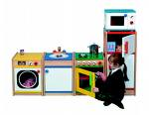
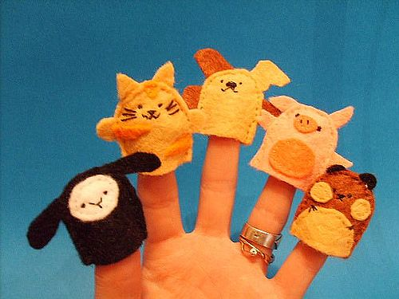
Speaking and Understanding
Through play
Children use language to imagine and recreate roles and experiences
Controlling their voice
Use talk to explain their ideas and feelings
Use language to ask for what they want and need
Songs, rhymes and stories

Slide 6
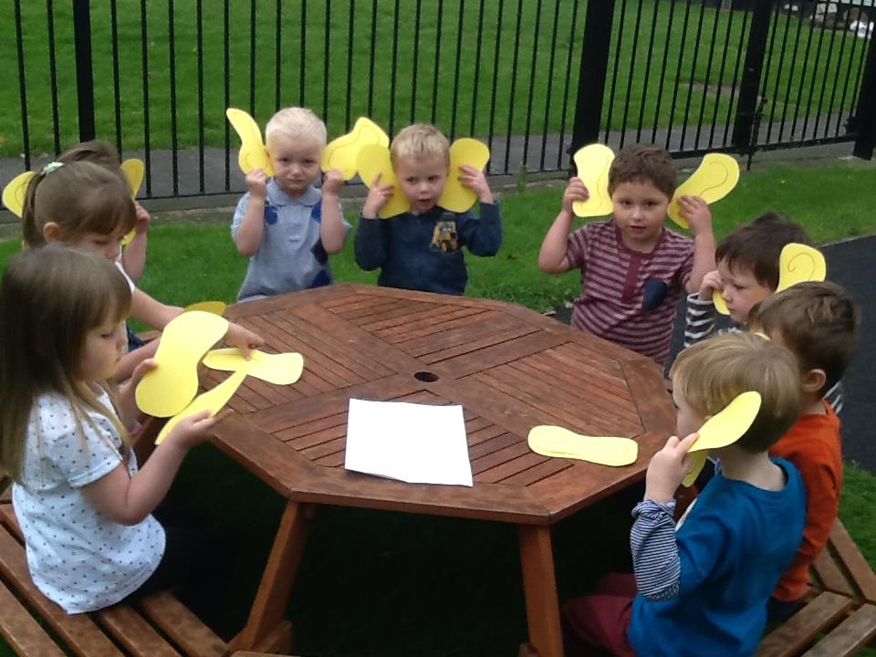

Slide 7
Phonics
We follow the Letters and Sounds scheme at Langley First School
Phonics is an important part of our curriculum. We teach phonics sessions daily through full class, small group and one to one sessions in a fun, engaging way.

Slide 8
Phase 1
Began in nursery
Listening to sounds in the environment
Instruments
Rhythm and rhyme
Alliteration
Oral blending
Oral segmenting.
We will focus on Phase 1 this year until we feel the children are secure to move on.

Slide 9
Phase 2 and 3
We then move on to phase 2 phonics and teach children to recognise letter sounds
Phase 2 and 3 includes the 26 letters of the alphabet, some digraphs (2 letters for 1 sound e.g “ch” and “ee”) and trigraphs (3 letters for 1 sound e.g. “igh”),
To help the children remember the sound that is usually made by each letter shape we tell them a simple story and reinforce with fun songs

Slide 10
The Early Years Curriculum
Reading, 40-60 months:
• Continues a rhyming string.
• Hears and says the initial sound in words.
• Can segment the sounds in simple words and blend them together and knows which letters represent some of them.
• Links sounds to letters, naming and sounding the letters of the alphabet.
•Begins to read words and simple sentences.
•Uses vocabulary and forms of speech that are increasingly influenced by their experiences of books.
• Enjoys an increasing range of books.
•Knows that information can be retrieved from books and computers.
Early Learning Goal: Children read and understand simple sentences. They use phonic knowledge to decode regular words and read them aloud accurately. They also read some common irregular words. They demonstrate understanding when talking with others about what they have read.

Slide 11
Blending to read
Sound buttons for each sound
So we would touch each button under each sound; s - a - t makes ‘sat’

Slide 12
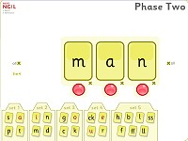
Helping your child at home
Letter sounds, not names- m,s t,p
Pure sounds, no “uh”sounds
http://www.ictgames.com/soundButtons/index.html

Slide 13
Segmenting
Breaking up the word into sounds- we do this to write words.
Phoneme/sound frames
sh
o
p

Slide 14
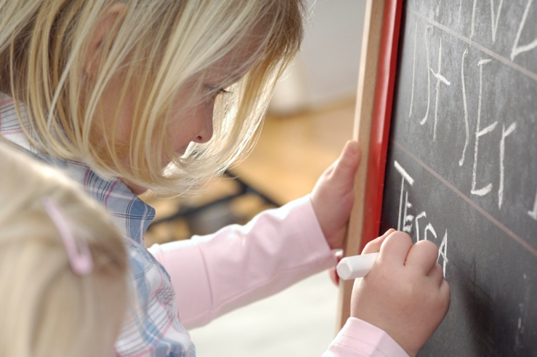
The Early Years Curriculum
Writing, 40-60 months:
•Gives meaning to marks they make as they draw, write and paint.
•Begins to break the flow of speech into words.
•Continues a rhyming string.
•Hears and says the initial sound in words.
•Can segment the sounds in simple words and blend them together.
•Links sounds to letters, naming and sounding the letters of the alphabet.
•Uses some clearly identifiable letters to communicate meaning, representing some sounds correctly and in sequence.
•Writes own name and other things such as labels,captions.
•Attempts to write short sentences in meaningful contexts.
Early Learning Goal: Children use their phonic knowledge to write words in ways which match their spoken sounds. They also write some irregular common words. They write simple sentences which can be read by themselves and others. Some words are spelt correctly and others are phonetically plausible.

Slide 15
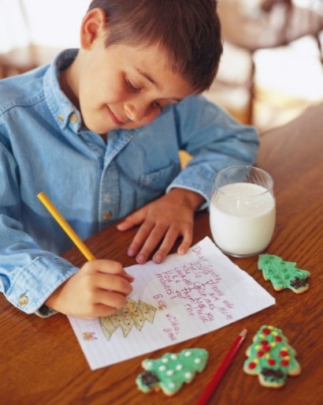
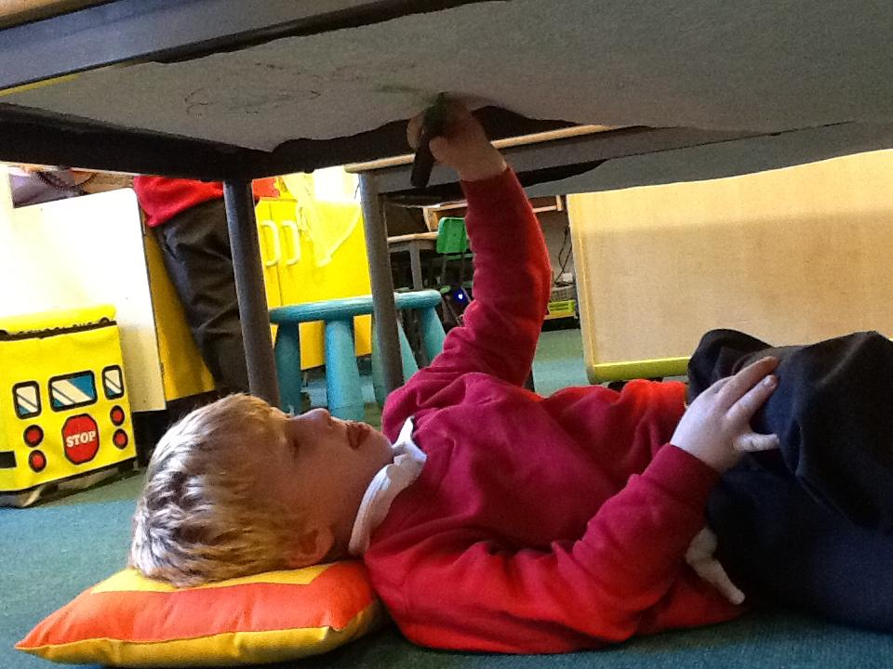
Before we teach writing we focus on developing muscles and fine and gross motor skills through playdough, drawing, cutting, building, threading, climbing, painting, stretching, chalking, dancing, carrying objects, providing opportunities to mark make in all areas of play.
Once we start writing it’s all about having a go, any writing is an achievement.
We model how to write letters, words and short sentences.

Slide 16
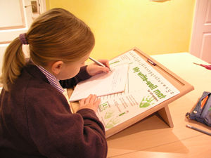
Tips for left handed children
Rotate the paper about 45 degrees clockwise (move the top to the right)
Hold the pen / pencil with a good "3 point grip" between the thumb, index and middle fingers
Keep the hand and wrist UNDER the writing line

Slide 17
Early stages of writing may just be ‘mark-making’ on a page but as knowledge of letters and sounds increases so their writing develops.

Slide 18
Reading
Children develop at different rates.
Main skills and attitudes that we want children to develop:
Love of books
Knowing how books work
Sight reading
Phonic skills

Slide 19
Speedy Words
For the children we call these High Frequency Words ‘Speedy Words’ and we teach the children to memorise the whole word rather than breaking it into sounds.
mum
to
the
go
I

Slide 20
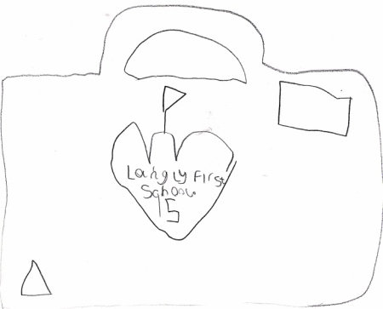
Reading at home
We will change your child’s reading books weekly and keep you updated on Tapestry. Our scheme is progressive and in line with where your child is at, at first books may be more focussed on the pictures and story to develop comprehension before text appears.
Continue to share and read your favourite stories at home too.
We will also have a weekly library service where children can bring a book home for pleasure to share.
We hope you have found this presentation useful.

